Slide 1
Primary health care (PHC)

Slide 2
Primary health care (PHC) provides essential nutrition services including growth monitoring, breastfeeding support, micronutrient supplementation (vitamin A, iron), and treatment of malnutrition, crucial for achieving universal health coverage.
It serves as the primary, community-level, preventive, and curative, approach to reducing malnutrition, targeting high-risk populations in rural and urban areas.

Slide 3
Key Aspects of Nutrition Coverage in PHC
Preventive Services: Nutritional counselling, promotion of breastfeeding, and advice on healthy diets.
Curative Services: Treatment of acute malnutrition, including wasting and stunting.
Supplementary Nutrition: Administration of micronutrient supplements (vitamin A, zinc, iron, folic acid).
Target Population: Focus on pregnant women, lactating mothers, and children under five.

Slide 4
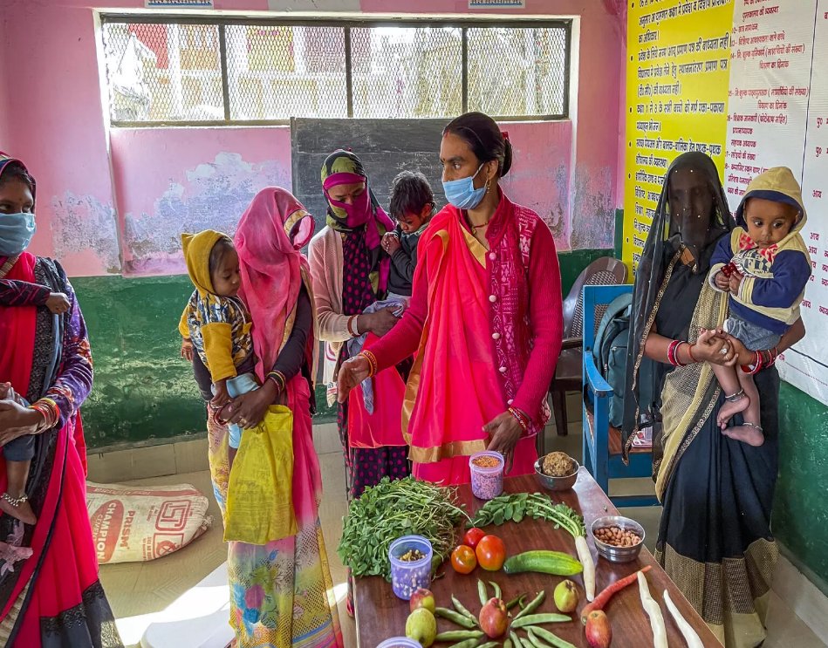
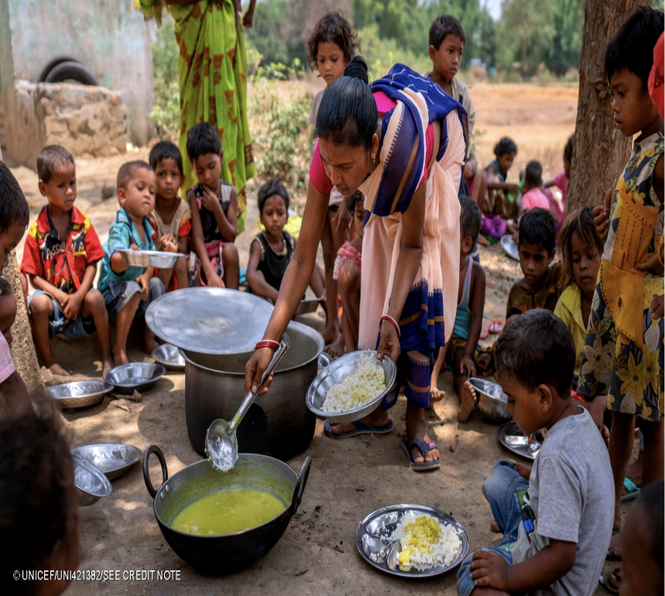
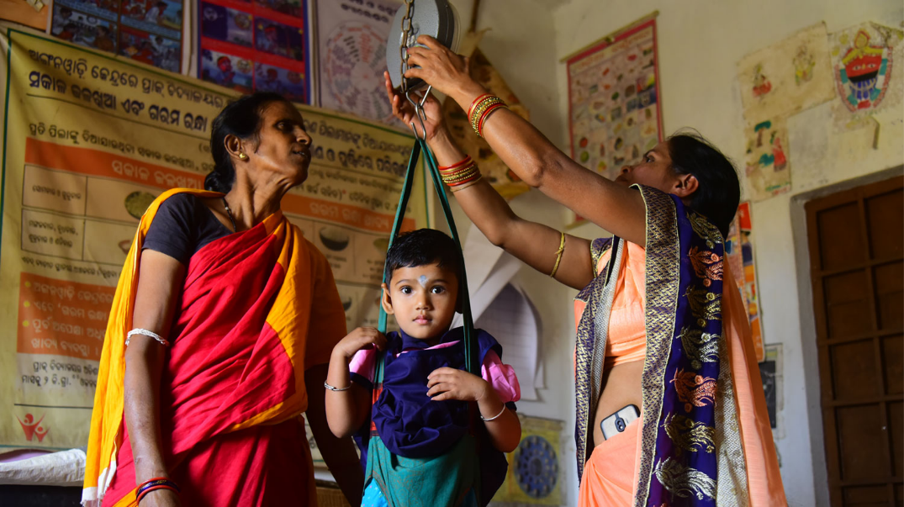

Slide 5
Integration: Nutrition is increasingly integrated into maternal and child health programs (e.g., in India, National Health Mission).
Effectiveness: Integrated nutrition interventions can reduce stunting by 20% and severe wasting by 61% when covering 90% of the population.

